Slide 1

Reducing Resting Heart Rate
By: Sly Espinoza

Slide 2
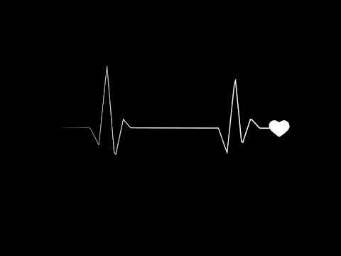
Introduction
When you sit quietly, your heart slips into a slower, steady pace known as your resting heart rate. This resting heart rate tends to be stable from day to day. The usual range for resting heart rate is anywhere between 60 and 90 beats per minute. Above 90 is considered high. An increase in your resting heart rate over time may be a signal of heart trouble ahead. Some ways to lower your resting heart rate include exercising, losing weight, and reducing stress.

Slide 3
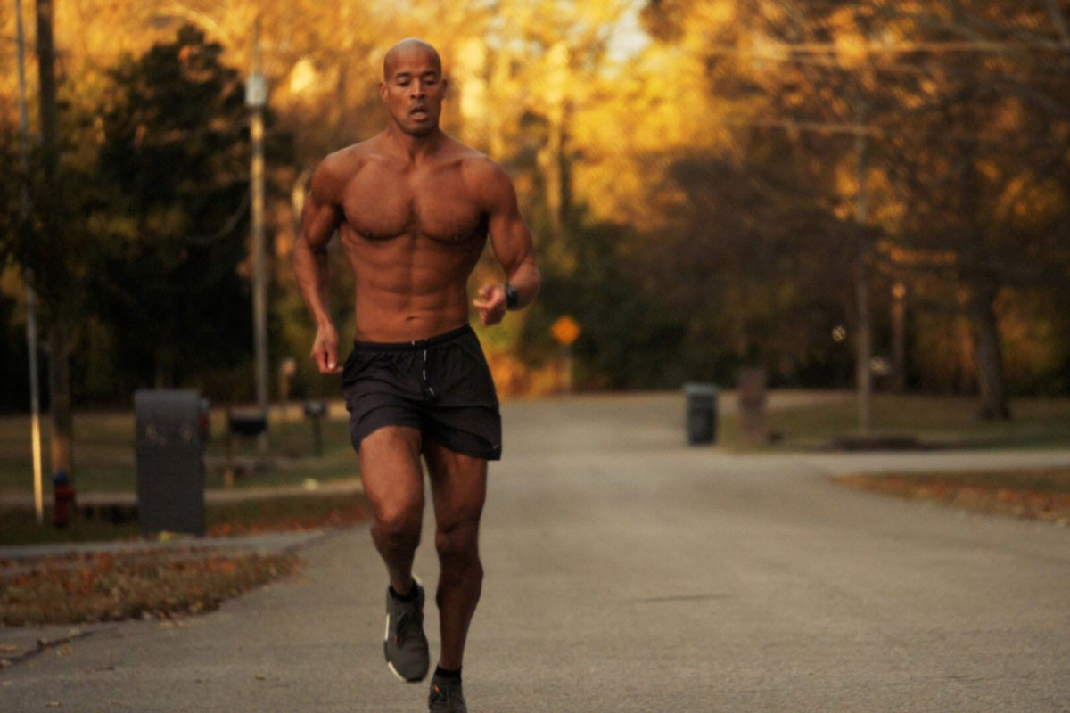
Purpose
The aim of this study was to verify if intensive exercise and healthy eating habits could lower a resting heart rate in just 1 week.

Slide 4
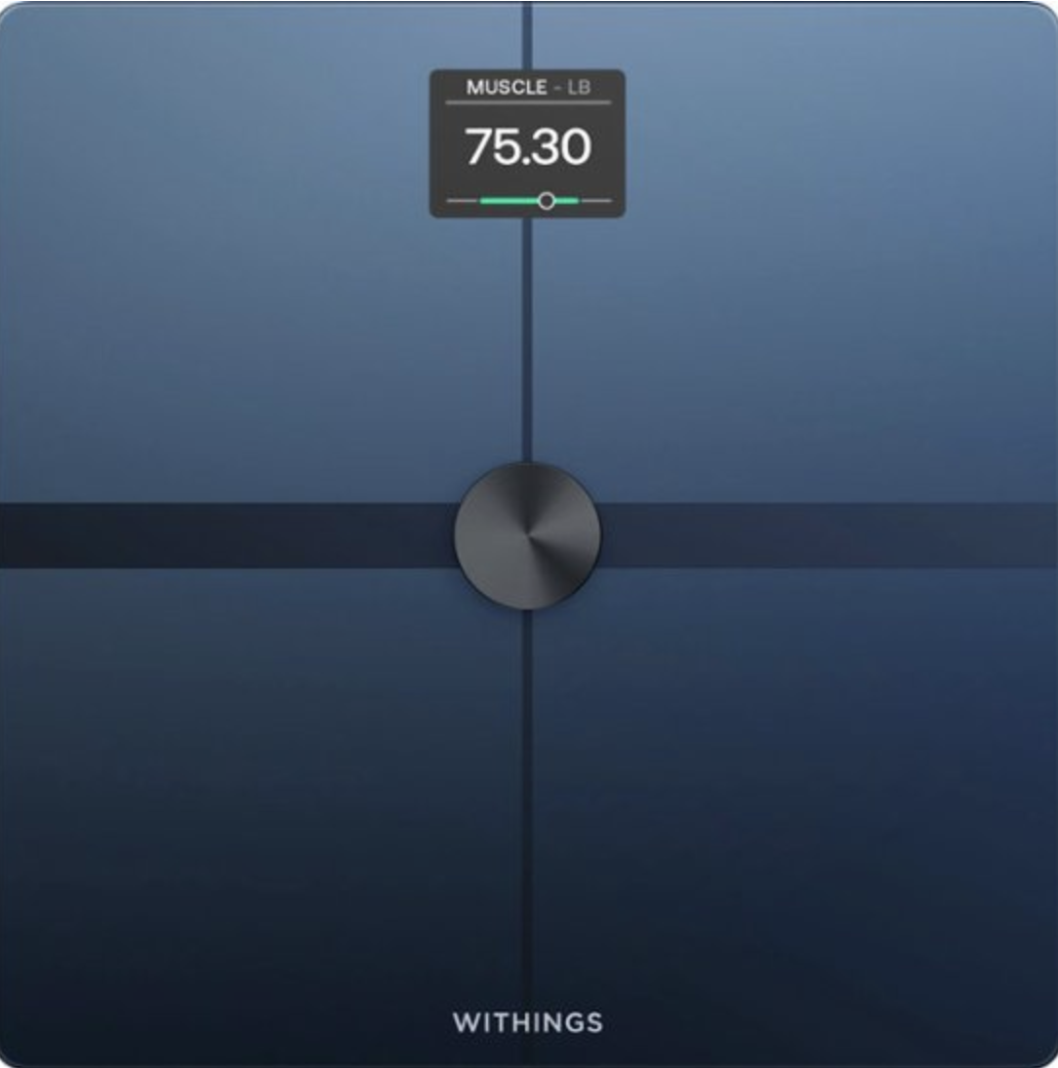
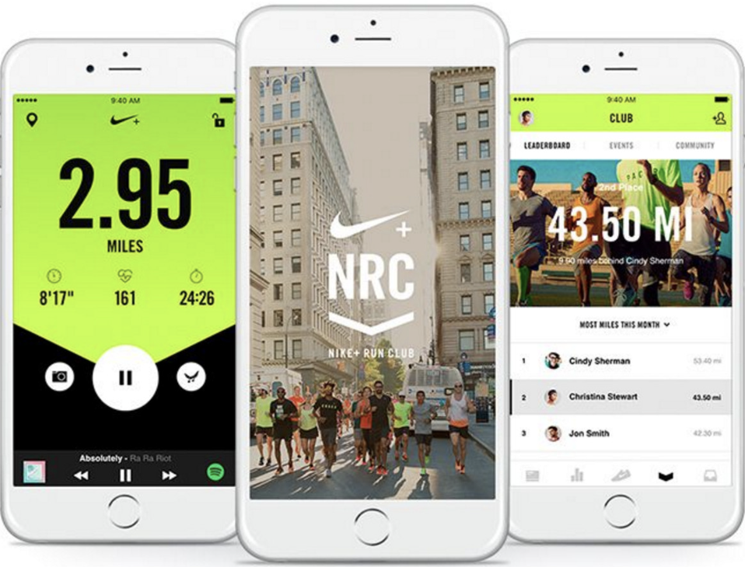
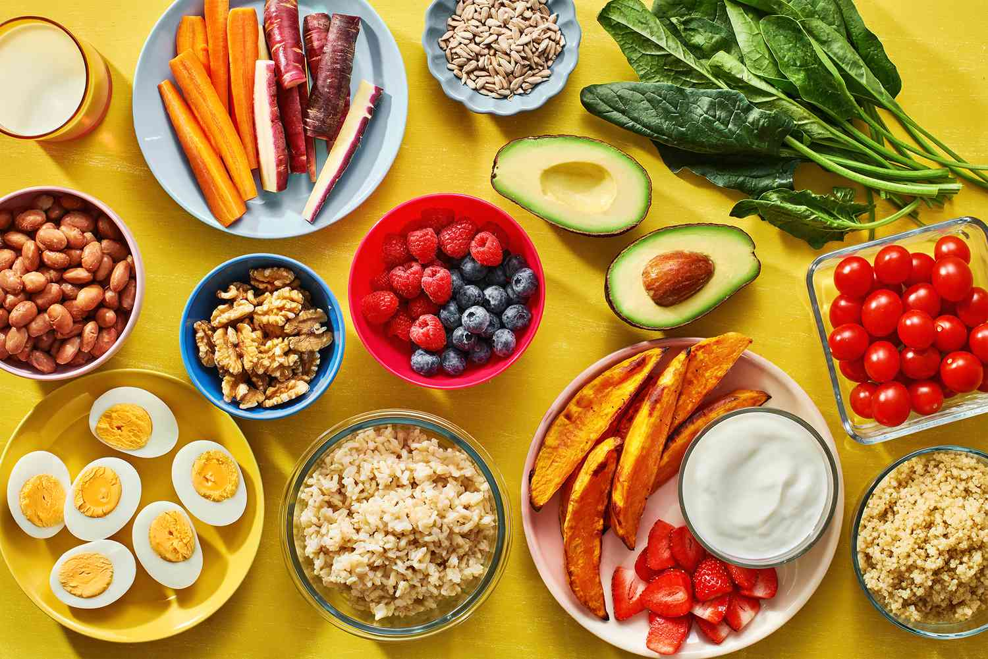
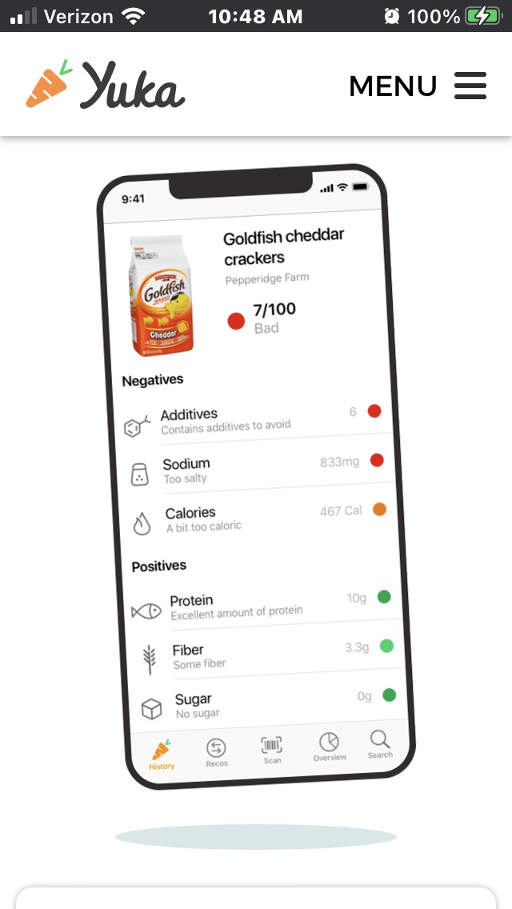
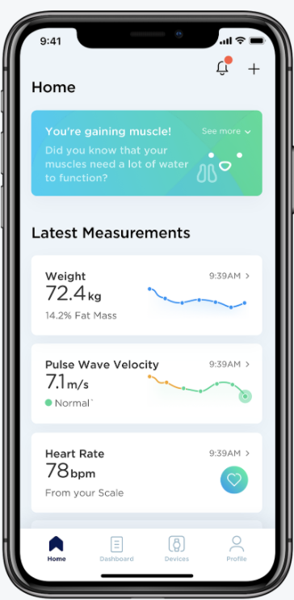
Materials
Smart Scale (BMI, body weight, body fat %, water weight, and muscle mass)
Nike Run App (distance, time, and calories)
Balanced diet
Yuka App
Withings App

Slide 5
Methods:
A male athlete (me) will do intensive exercise for 7 consecutive days. This includes running and bodyweight exercises.
During the 7 days of exercise, a balanced diet will be consumed.
On day 1 and day 7, my resting heart rate will be measured to see the difference (if any).
Each morning I will weigh myself, measure my BMI, body fat %, water mass %, muscle mass %, and bone mass %.

Slide 6
Procedures:
Measure resting heart rate (day 1 and day 7 only)
Weigh in
Eat
Stretch
Exercise

Slide 7
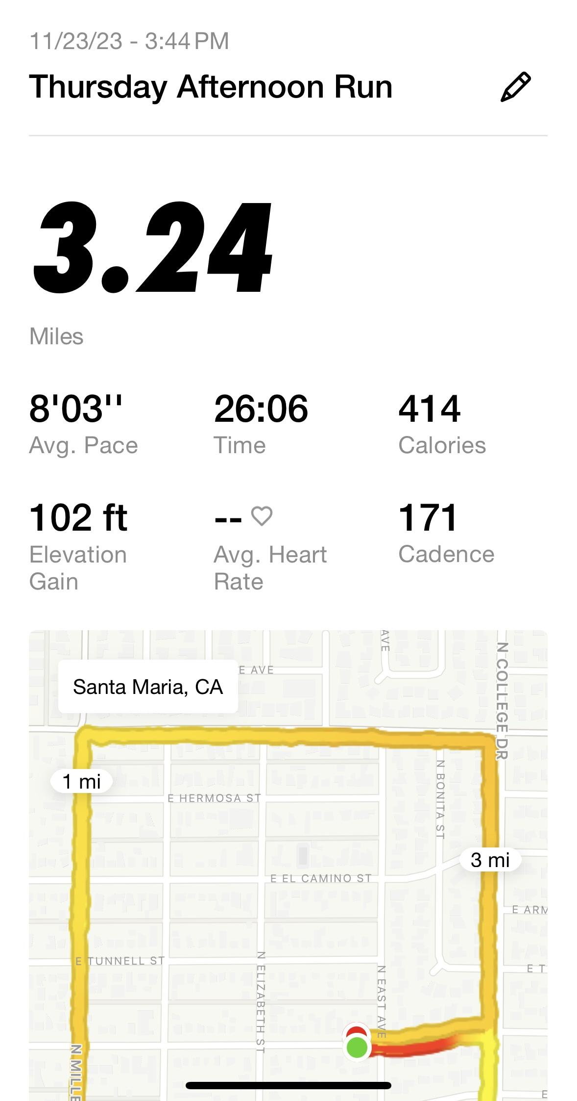
Day 1
RHR: 52 BPM
Body Weight: 174.5 lbs
BMI: 27.3
Water Mass %: 53.6
Fat Mass %: 26.5
Muscle Mass %: 69.7
Bone Mass % 3.7
Breakfast: Protein cinnamon raisin bagel with low fat cream cheese, 2 eggs, vanilla greek yogurt
Lunch: 2 turkey sandwiches
Dinner: 3 turkey burgers
Snacks: roasted dark chocolate almonds, peanuts
Fluids: water
Workout: 3.24 mile run

Slide 8
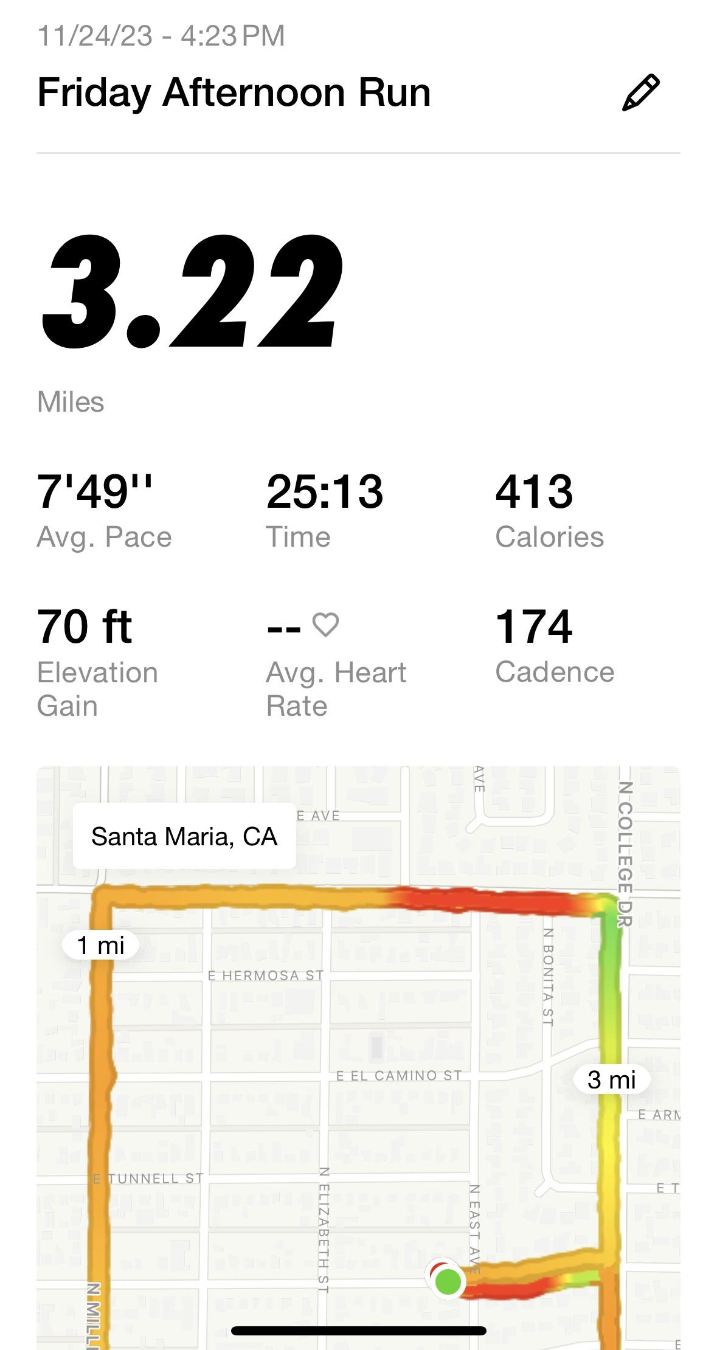
Day 2
Body Weight: 173.7 lbs
BMI: 27.2
Water Mass %: 53
Fat Mass %: 27.9
Muscle Mass %: 68.4
Bone Mass % 3.7
Breakfast: Cheerios with almond milk, protein cinnamon raisin bagel, vanilla greek yogurt
Lunch: white rice mixed with peas, lightly breaded chicken nuggets
Dinner: 2 turkey burgers
Snacks: no snacks
Fluids: water, almond milk
Workout: 3.22 mile run

Slide 9
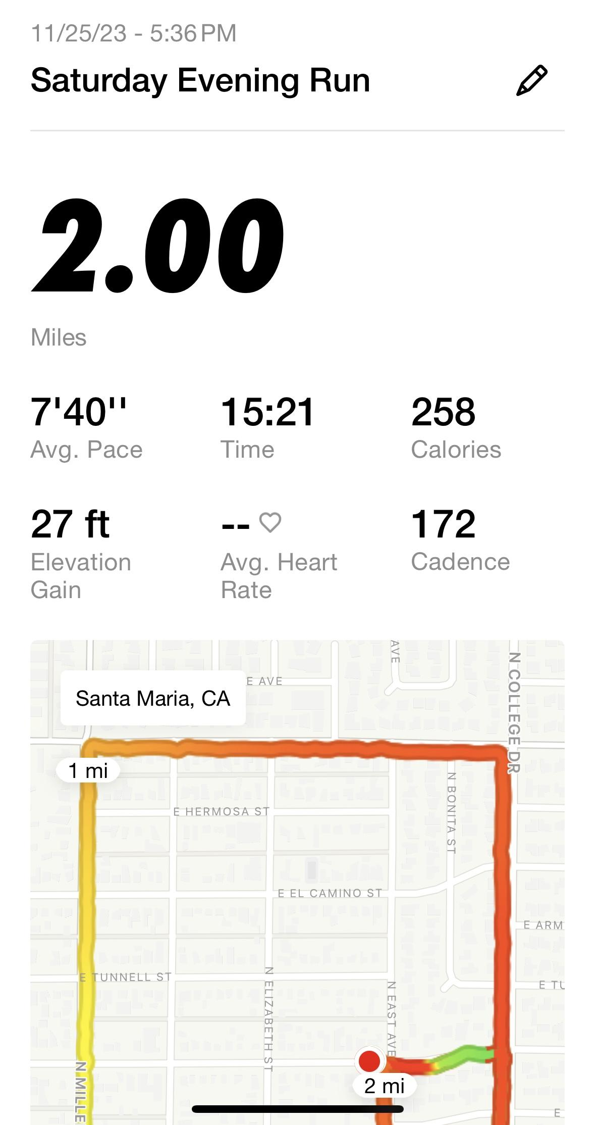
Day 3
Body Weight: 173.7 lbs
BMI: 27.2
Water Mass %: 53.9
Fat Mass %: 25.9
Muscle Mass %: 70.3
Bone Mass % 3.8
Breakfast: Protein cinnamon raisin bagel, vanilla greek yogurt
Lunch: 3 turkey sandwiches
Dinner: chicken with white rice, mushrooms, bell peppers, squash, and green onion
Snacks: roasted dark chocolate almonds, white rice with peas and corn
Fluids: water
Workout: 2 mile run

Slide 10
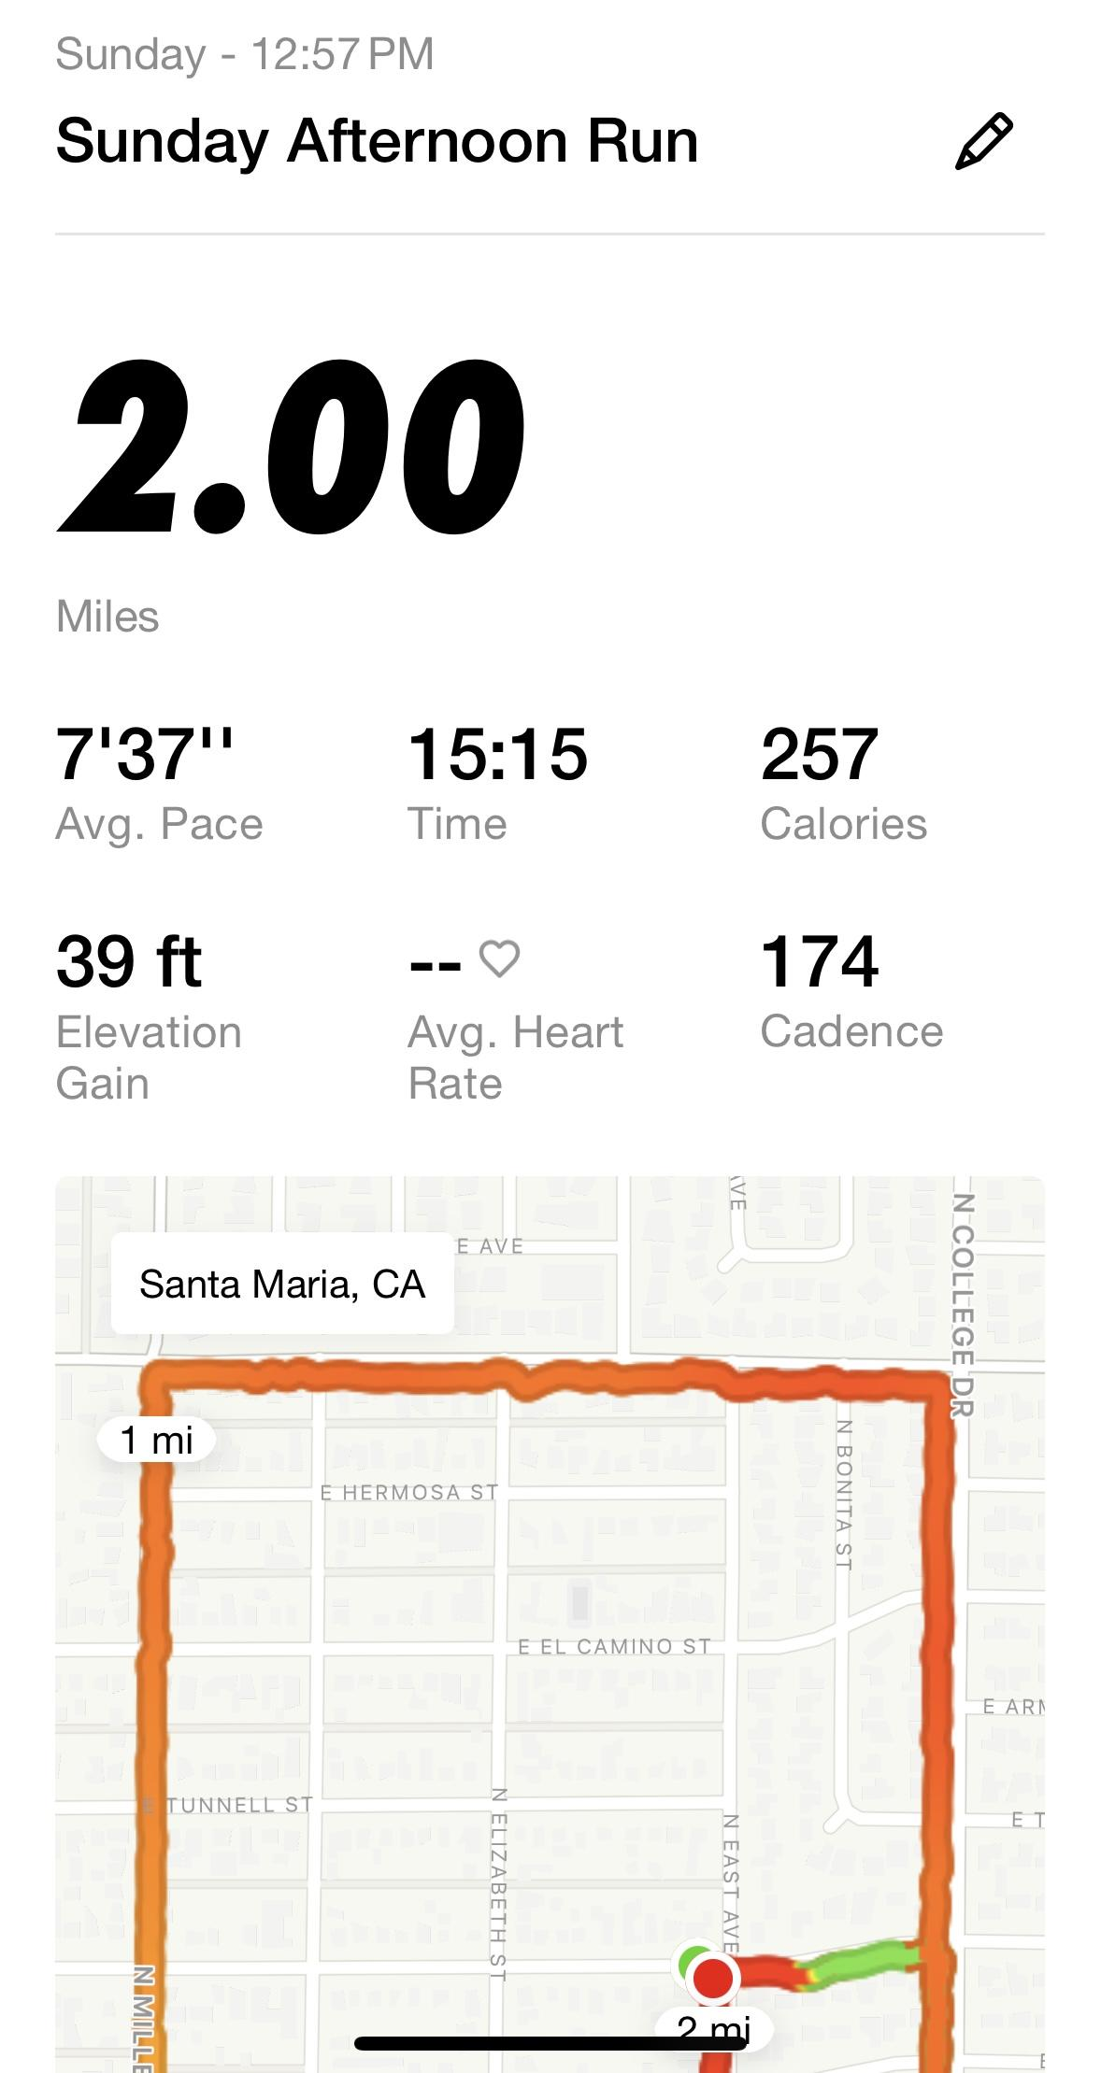
Day 4
Body Weight: 172.5
BMI: 27
Water Mass %: 53.9
Fat Mass %: 26
Muscle Mass %: 70.2
Bone Mass % 3.8
Breakfast: Half of a protein cinnamon raisin bagel, 2 eggs, white rice
Lunch: caesar salad, 2 peanut butter and jelly sandwiches
Dinner: lightly breaded chicken tenders
Snacks: 1 banana, whole wheat ritz crackers, 2 boiled eggs (egg whites only), white rice with green beans, peas, and corn
Fluids: water, almond milk
Workout: 2 mile run

Slide 11
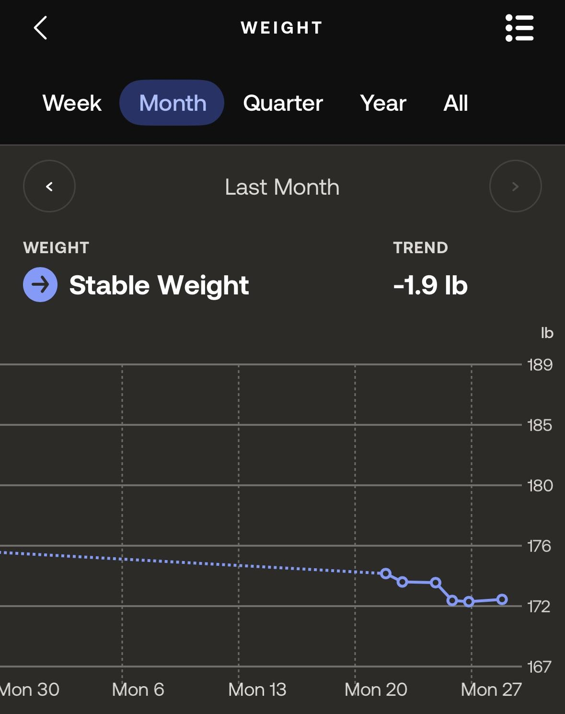
Day 5
Body Weight: 172.4 lbs
BMI: 27
Water Mass %: 54.2
Fat Mass %: 25.3
Muscle Mass %: 70.9
Bone Mass % 3.8
Breakfast: 1 banana, vanilla greek yogurt
Lunch: chicken with white rice, mushrooms, bell peppers, squash, and green onion
Dinner: lightly breaded chicken breast, mexican rice, black beans
Snacks: protein bar, 1 banana, baked hot cheetos, 2 slices of pizza, 1 breadstick, 1 fudge popsicle
Fluids: water
Workout: 100 pushups and 100 situps

Slide 12
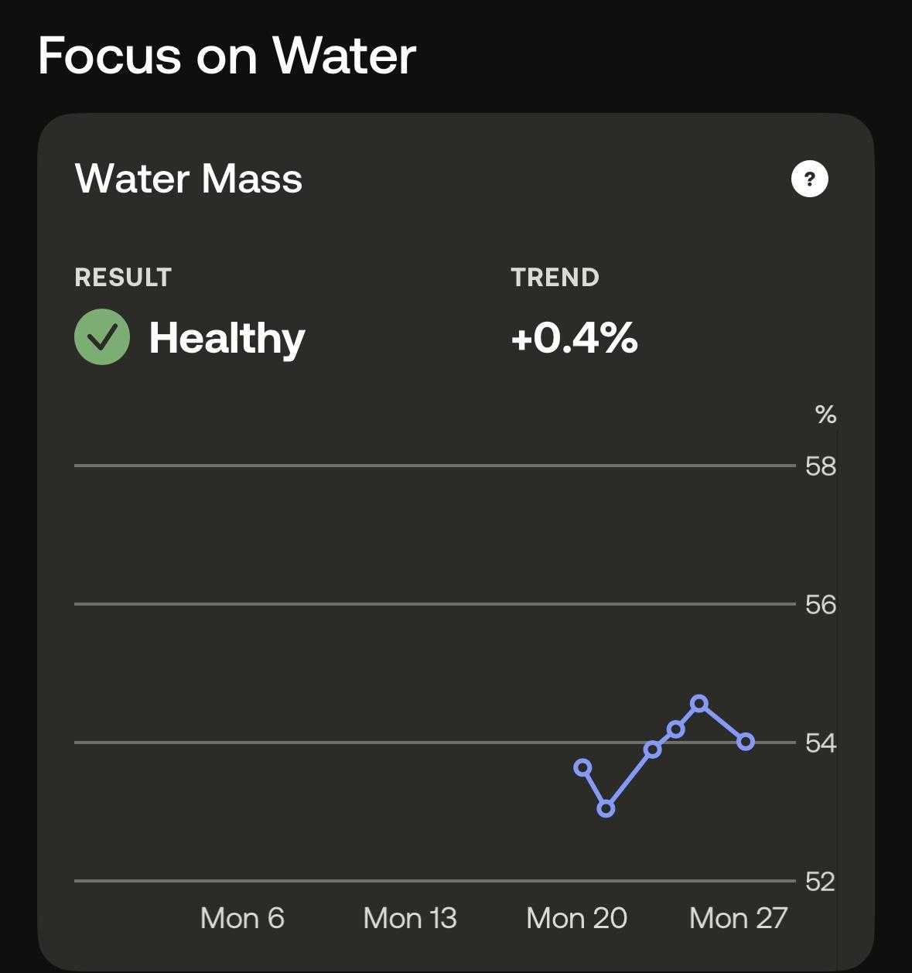
Day 6
Body Weight: 172.3 lbs
BMI: 27
Water Mass %: 54.6
Fat Mass %: 24.6
Muscle Mass %: 71.6
Bone Mass % 3.8
Breakfast: 1 banana, protein bagel, vanilla greek yogurt
Lunch: creamy tomato pasta
Dinner: mexican rice, chicken, salad
Snacks: gerber baby biscuits, pb&j, baked hot cheetos
Fluids: water, milk
Workout: 200 pushups and 200 sit ups

Slide 13
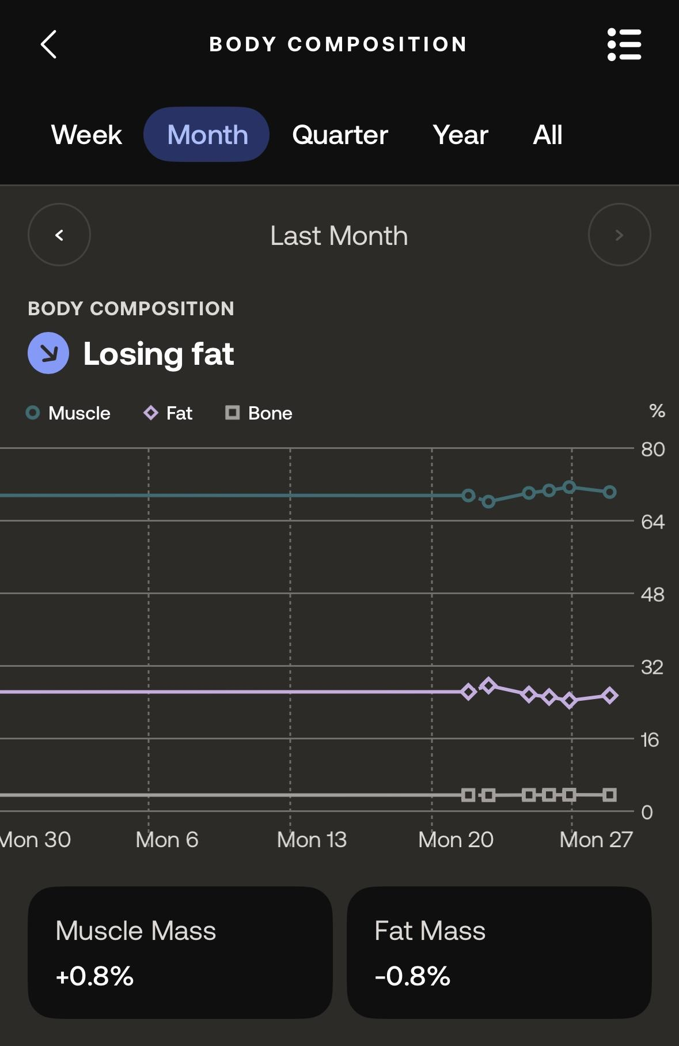
Day 7
RHR: 44 BPM
Body Weight: 172.5 lbs
BMI: 27
Water Mass %: 54
Fat Mass %: 25.7
Muscle Mass %: 70.5
Bone Mass % 3.8
Breakfast: protein bagel with cream cheese, 1 banana
Lunch: 2 pb&j’s
Dinner: white rice, canned salmon, lime, seaweed
Snacks: Cheerios with whole milk
Fluids: water, whole milk
Workout: 300 pushups and 300 sit ups

Slide 14
Results
Resting heart rate on day one: 52 beats per minute
Resting heart rate on day seven: 44 beats per minute

Slide 15
Discussion
Consistency
No fancy meals, everything basic
Healthy alternatives
Affordable food
Affordable workouts
Busy but progressive

Slide 16
Conclusion
To conclude, I was able to reduce my resting heart rate by 8 beats per minute. This also resulted in me losing 2 lbs and feeling healthier overall. I hope this experiment is also successful in encouraging my classmates to pursue a healthier lifestyle as well. CONSISTENCY IS KEY!

Slide 17
Sources
https://www.health.harvard.edu/blog/increase-in-resting-heart-rate-is-a-signal-worth-watching-201112214013
https://www.frontiersin.org/articles/10.3389/fphys.2020.00979/full

Slide 18

Questions?

